Slide 1
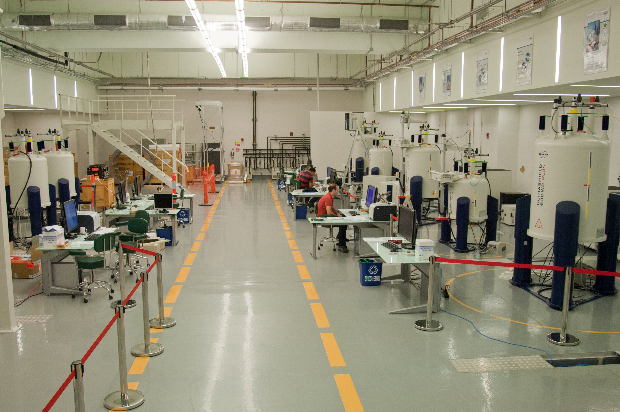
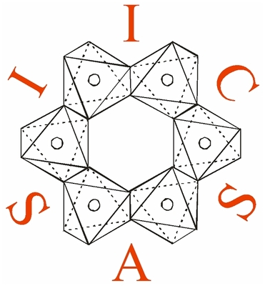
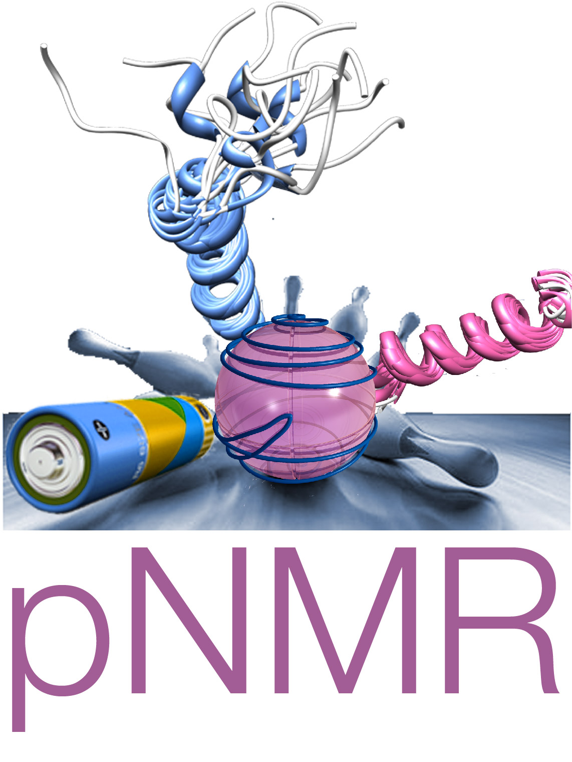

Fully relativistic calculations of magnetic resonance parameters with application to paramagnetic NMR.

Slide 2
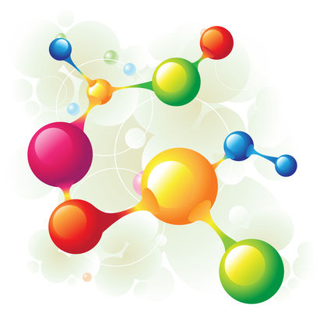
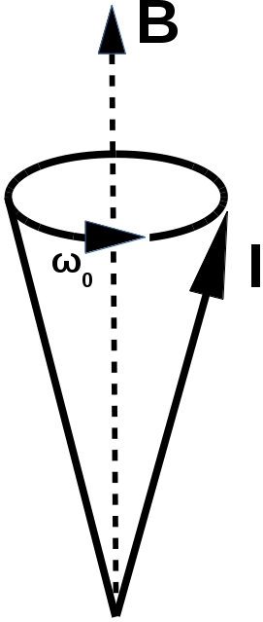
Nuclear Magnetic Resonance (NMR)
Characterize system based on its response to an external magnetic field.
Nuclear spins will precess about the magnetic field.
This is the Larmor precession, it is what experiments measure.
The frequency of the Larmor precession influenced by
1) Nuclear isotope.
2) Electron-nuclear interactions.
3) Nuclear-nuclear interactions.
4) And many others....
Fig. 1: Larmor precession cone.
Fig 2: Nucleon.

Slide 3
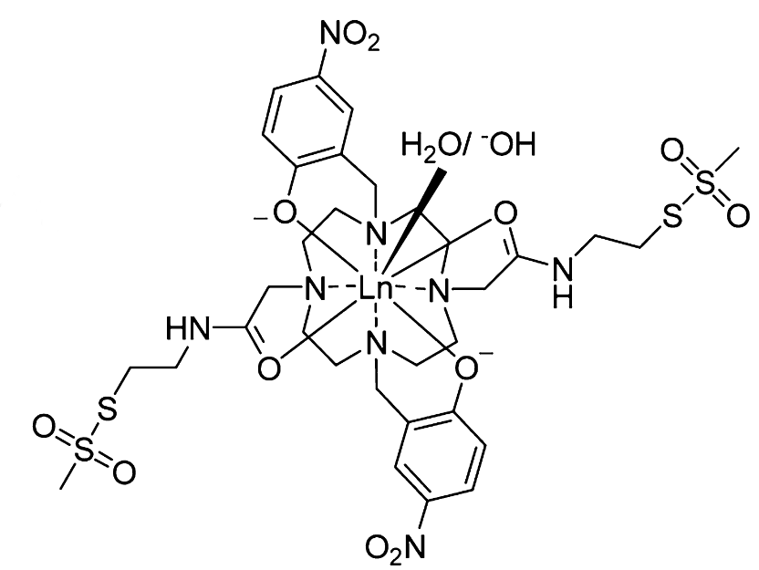
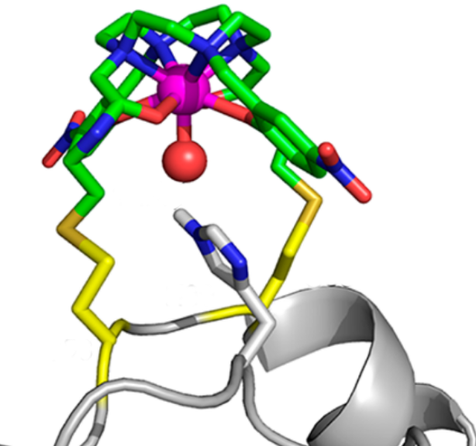
Structure Determination with pNMR
Investigation of paramagnetic proteins and paramagnetic tagging of diamagnetic proteins is becoming more widespread.
Paramagnetic NMR can supplement information obtained from diamagnetic NMR.
(a)
(b)
[2] W.-M. Liu, P. H. Keizers, M. A. Hass, A. Blok, M. Timmer, A. J. Sarris, M. Overhand, and M. Ubbink, JACS 134, 41 17306 (2012).
Fig.4 (a) Lewis structure of CLaNP-7 parmagnetic tag (b) CLaNP-7 binding to protein [2].

Slide 4
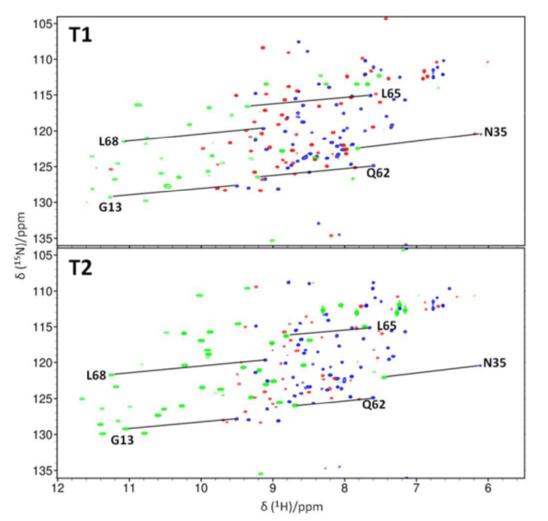
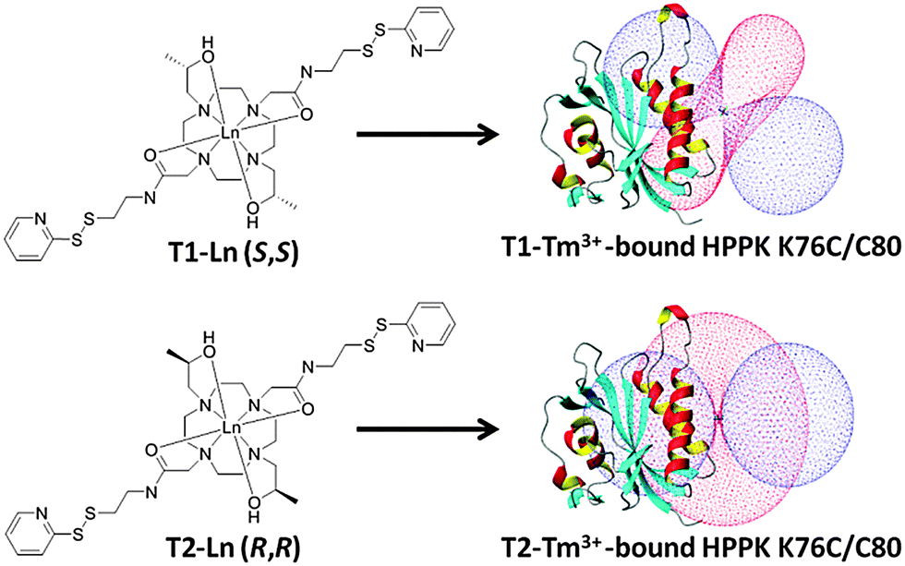
Pseudocontact shift and residual dipolar coupling
(a)
(a)
(b)
(b)
Fig. 7 (a) & (b) 2D spectra corresponding to tags in Fig. 5 (a) & (b).
Fig. 5 (a) & (b) Protein with para-magnetic tag bound in two different positions.
[2] M. D. Lee, M. L. Dennis, J. D. Swarbrick, and B. Graham, Chemical Communications, 52, 7954 (2016).

Slide 5
Paramagnetic tagging
Attaching a paramagnetic tag to the protein influences the spectra.
Two main effects:
Pseudocontact shift (PCS): Coupling of nucleus with electron spin-density.
Residual Dipolar Coupling (RDC): more complicated ….
(a)
(b)
[3] M. D. Lee, M. L. Dennis, J. D. Swarbrick, and B. Graham, Chemical Communications, 52, 7954 (2016).
Fig. 5 (a) & (b) Protein with para-magnetic tag bound in two different positions [3].

Slide 6
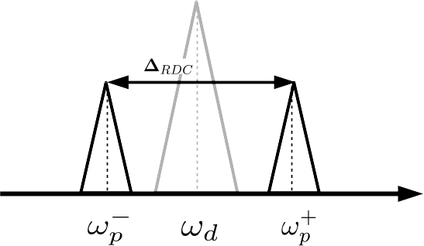
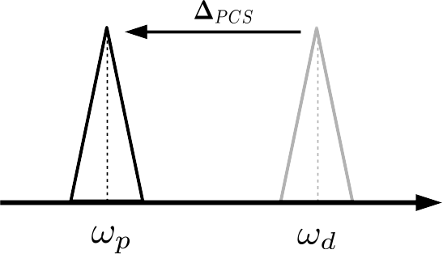
Pseudocontact shift and residual dipolar coupling
Residual dipolar coupling
(a)
Compare diamagnetic and paramagnetic spectra.
Changes in peak positions are caused by pseudocontact shift or residual dipolar coupling.
Size of these shifts is determined by the position of the nucleus relative to the paramagnetic center.
Often only a few ppm.
Pseudocontact shift
(b)
Fig. 6 Changes in spectra arising from (a) residual dipolar coupling and (b) pseudo contact shift.

Slide 7
Paramagnetic spin-spin coupling enhancement
Measurement of this coupling is often central to Correlation Spectroscopy, and several other techniques.
Measurement of spin-spin coupling constants (SSCCs) in paramagnetic systems is difficult due to fast nuclear relaxation rates.
Theory of nuclear spin-spin coupling was developed for diamagnetic systems.
Q) Is J-coupling qualitatively different in systems with unpaired electrons?
If SSCCs are needed for paramagnetic systems they are approximated with SSCCs for a similar diamagnetic system.
Q) When is this approximation valid?

Slide 8
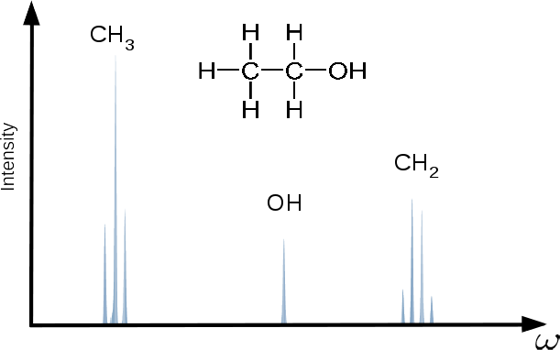
Through bond spin-spin coupling
Fig. 3 : 90 MHz Proton NMR spectra for ethyl alcohol in CDCl₃ .Data retrieved from spectral database for organic compounds[2].
[2] http://sdbs.db.aist.go.jp/sdbs/cgi-bin/direct_frame_disp.cgi?sdbsno=13

Slide 9
J-coupling
Fig. 3 : 90 MHz Proton NMR spectra for ethyl alcohol in CDCl₃ .Data retrieved from spectral database for organic compounds[2].
[2] http://sdbs.db.aist.go.jp/sdbs/cgi-bin/direct_frame_disp.cgi?sdbsno=13

Slide 10
J-coupling
Fig. 3 : 90 MHz Proton NMR spectra for ethyl alcohol in CDCl₃ .Data retrieved from spectral database for organic compounds[2].
Can the J-coupling theory for diamagnetic systems be applied to paramagnetic ones?
[2] http://sdbs.db.aist.go.jp/sdbs/cgi-bin/direct_frame_disp.cgi?sdbsno=13

Slide 11
Through space nuclear spin-spin coupling
The spins of different nuclei can interact via dipolar coupling:
Interaction given by:

Slide 12
Through bond spin-spin coupling
Interaction is mediated by electron charge density:
In diamagnetic systems there are no unpaired electrons.
Nuclear spin-spin interaction is mediated by the currents which the nuclear moments induce in the electron density.
e⁻
e⁻
e⁻
e⁻
e⁻
e⁻
e⁻
e⁻
e⁻
e⁻
e⁻
e⁻
e⁻
e⁻

Slide 13
Pseudocontact shift
Interaction of nuclear moment with electron spin density.
Unique to paramagnetic systems; it is only possible when there are unpaired electrons.

Slide 14
Spin-spin coupling enhancement
Interaction is mediated by electron spin density:
Paramagnetic systems have unparied electrons and the nuclear spins can interact via the electron spins.

Slide 15
Paramagnetic J-coupling enhancement
Presence of electron spin density will effect J-coupling.
The hyperfine interaction couples nuclear spins to the electron spin density.
Spin density then “transmits” interaction of nuclear spins.
The resulting contribution to the nuclear spin-spin interaction is given by:

Slide 16
Hyperfine terms
New contribution: Electron spins will couple to nuclear spins.
The hyperfine interaction couples nuclear spins to the electron spin density.
Spin density then “transmits” interaction of nuclear spins.
The resulting contribution to the nuclear spin-spin interaction is given by:

Slide 17
SS dyadic
New contribution: Electron spins will couple to nuclear spins.
The hyperfine interaction couples nuclear spins to the electron spin density.
Spin density then “transmits” interaction of nuclear spins.
The resulting contribution to the nuclear spin-spin interaction is given by:

Slide 18
Paramagnetic J-coupling enhancement
Presence of electron spin density will effect this coupling.
Hyperfine interaction couple nuclear spins to the electron spin density.
Nuclear spin-spin interaction will also be mediated by spin density.
Enhancement is given by:
No dependence on distance between nuclei!

Slide 19
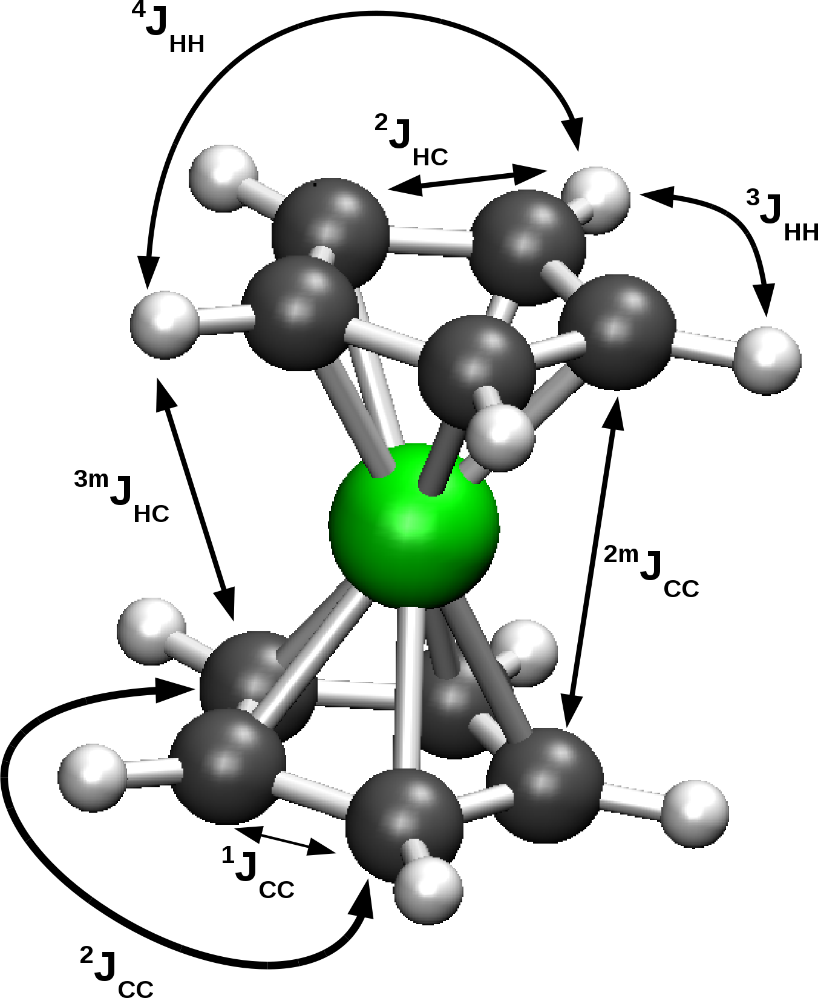
J-enhancement in metallocenes
 | J(Hz) | ∆J(Hz)
 | FeCp₂ | NiCp₂ | CrCp₂
³J_{HH} | 8.0 | 0.65 | 1.50
⁴J_{HH} | -0.1 | 0.82 | 1.17
¹J_{CC} | 88.5 | 5.42 | -0.02
²J_{CC} | -4.1 | 5.63 | -0.17
¹J_{CH} | 172.9 | -1.17 | -0.04
¹J_{CH} | 3.8 | -1.79 | -0.51
²J_{CH} | 3.8 | -1.90 | -0.74
³J_{HH} | 0.0 | 1.24 | 1.79
^{2m}J_{HH} | -0.3 | 5.66 | 0.11
^{3m}J_{CH} | 0.0 | -1.66 | -0.48
Table 1: Comparison between unenhanced isotropic J-values for ferrocene, and the corresponding enhancement in nickelocene and chromocene.
Fig. 8: Metallocene structure. Hydrogens
→ white. Carbons → grey. Metal → green.

Slide 20
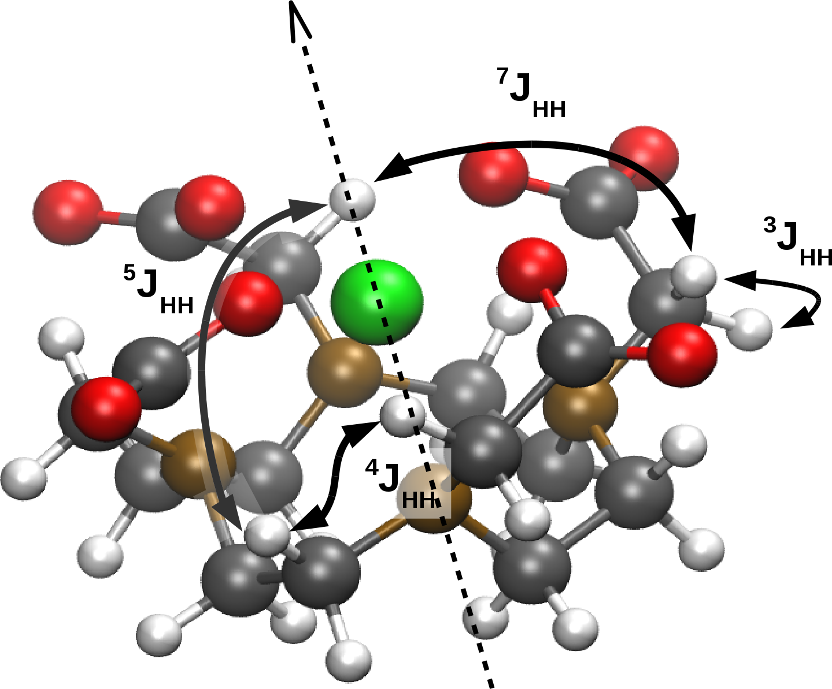
J-enhancement in Gd-DOTA
 | ∆J^{iso}(Hz) | ∆J^{aniso}(Hz)
³J_{HH} | 2.40 | -1.35
⁴J_{HH} | 2.58 | -1.99
⁵J_{HH} | 6.59 | -5.4
⁷J_{HH} | -3.27 | 9.41
Table 2: Enhancement to isotropic and anisotropic J-values for Gd-DOTA.
Fig. 9: Gd-DOTA structure. Oxygen → red. Nitrogen → brown. Other elements as before.

Slide 21
Paramagnetic spin-spin coupling enhancement
Q) Is J-coupling qualitatively different in systems with unpaired electrons?
A) Yes, nuclear spins are coupled by the electron spin-density, and there is no direct dependence on the distance between the nuclei.
If SSCCs are needed for paramagnetic systems they are approximated with SSCCs for a similar diamagnetic system.
Q) When is this approximation valid?
A) Most of the time... However, in systems with diffuse spin density and multiple coupled paramagnetic centres this effect could be significant.

Slide 22
Electron Paramagnetic Resonance (EPR)
Characterize system based on its response to an external magnetic field.
The frequency of the Larmor precession influenced by interations with
1) Nuclear potential
Hyperfine splitting
Spin-orbit coupling
2) Other electrons:
Gaunt interaction
Breit interaction
Fig. 1: Larmor precession cone.
Fig 2: Electron.

Slide 23
Applying EPR to biological systems
g-tensor is determined by the environment surrounding the paramagnetic centre.
Can provide information about the orientation of molecules with respect to the docking site.
Several organic compounds of interest exhibit regions of of negative spin density and/or exist in low spin states.
Q) How well is g-tensor theory adapted to unrestricted and/or broken symmetry DFT?
[1] M. Kaupp, Biochemistry 41.9, 2895, (2002).
[2] D. A. Dougherty, Accounts of chemical research 24.3, 88 (1991).

Slide 24
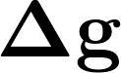
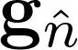
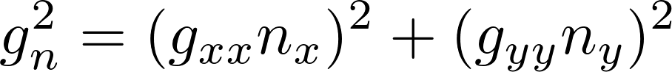
An interpretation of the g-tensor
Attempt to describe magnetic moment of system using a single “pseudospin”.
Each direction of magnetic field defines a point on the surface.
Distance from centre to the surface determine g-shift.
Equation for point on oval:

Slide 25
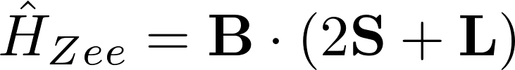
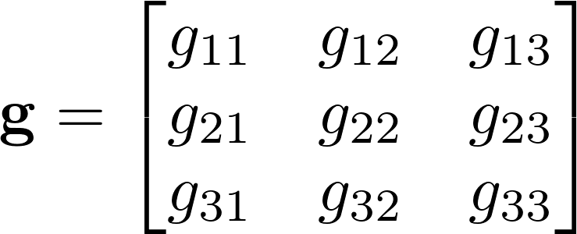
Zeeman splitting and the g-tensor
Interaction determined by Zeeman operator:
Interaction between magnetic moment of spin.
Anisotropic; different splittings associated with different orientations of magnetic field.
Use g-tensor to plot spectrum:

Slide 26
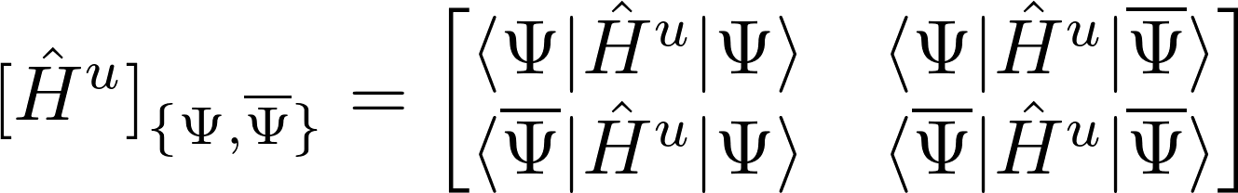
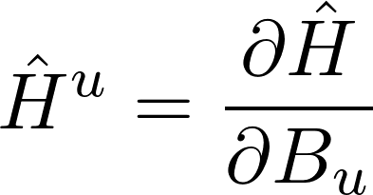
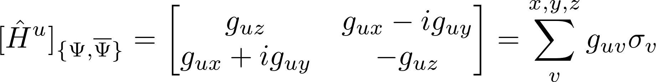
Restricted basis Hamiltonian
Hamiltonian:
Make use of properties of KP to rewrite as

Slide 27
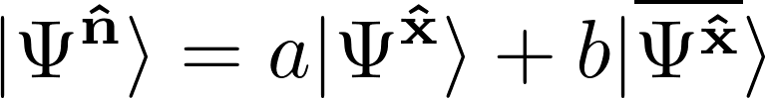
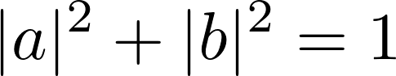
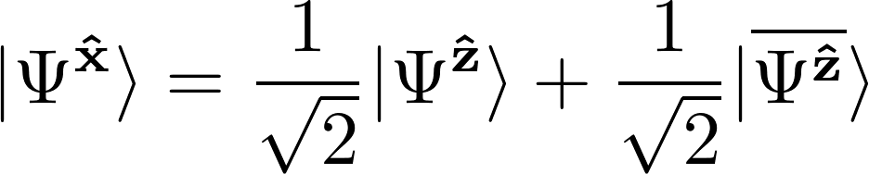
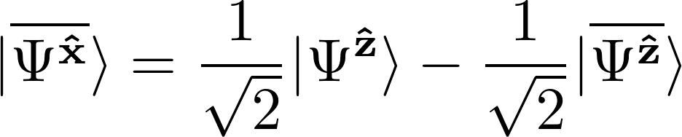
Rotations of spin using KP
Use a linear combination of Kramers pairs to describe wavefunction with rotated spin:

Slide 28
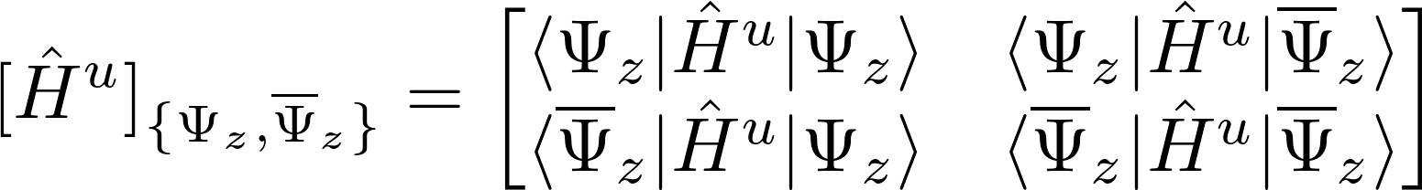
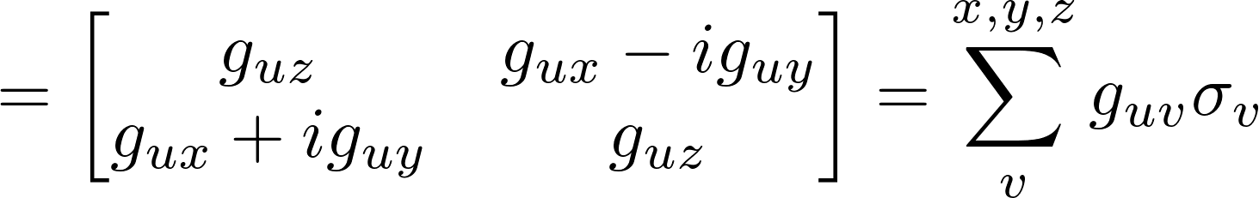
Rotations of spin using KP
Take spin along z:
Rewrite all matrix elements in terms of expectation values:

Slide 29
Unrestricted and noncollinear determinants
Restricted, spin collinear
Unrestricted, spin collinear
Unrestricted, spin non-collinear

Slide 30
Unrestricted and noncollinear determinants
Unrestricted collinear: Common electron spin axis, spin channels have different orbitals.
Pros:
Can describe negative spin density.
Can be used for broken symmetry systems.
Easier to programme than collinear restricted.
Cons:
Bad value of S2; spin contamination effects.
Individual orbitals do not, usually, obey Kramers symmetry.
More difficult to evaluate properties.

Slide 31
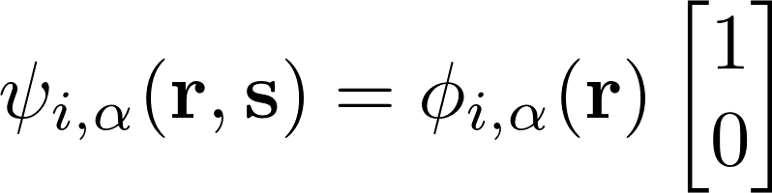
Unrestricted and noncollinear determinants
Restricted: Single spin polarization axis, both spin channels have the same spatial orbitals.
Pros:
Fewer parameters to optimize.
Good value of S².
Cons:
No negative spin density.
Impossible to describe triplets via broken symmetry DFT

Slide 32
Unrestricted and noncollinear determinants
Unrestricted non-collinear: No constraints on either spin or spatial component of individual orbitals.
Pros:
Good for describing spin-orbit; the spatial component can couple to the spin component.
Cons:

Slide 33
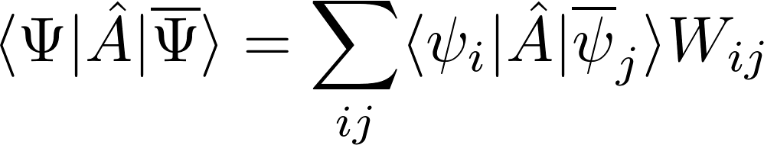
Rotations of spin using unrestricted KP
Evaluation of matrix elements is straightforward in the restricted case:
In the unrestricted case several cancellations are no longer possible, and the expression is more complicated:
Naive evaluation scales as N!, newer algorithm scales as N⁴, but it turned out Per Olov Loewdin had discovered this long ago.......

Slide 34
Application to simple systems
Molecule |  | ReSpect | Experiment ^{a,b} | Discrepancy
H₂CO+ | g_{x} | 0.9 | 4.6 | 3.7
 | g_{y} | 11.0 | 0.2 | 10.8
 | g_{z} | -0.9 | -0.8 | 0.1
H₂O+ | g_{x} | 4.7 | 0.2 | 4.5
 | g_{y} | 6.4 | 18.8 | 12.4
 | g_{z} | 3.7 | 4.8 | 1.1
Table 1. g-shift values in ppt. The molecules are in yz-plane, where z is along the main roation axis. ReSpect calculations were performed with spin parallel to the main rotation axis.
ªNe:H2CO matrix isolation result, from Knight et al. [L. B. Knight and J. Steadman, J. Chem. Phys. 80, 1018 (1984)]
^{b} H₂O+: Gas phase results derived from spin rotation data, from Knight et al.[ L. B. Knight and J. Steadman, J. Chem. Phys. 78, 5940 (1983)]

Slide 35
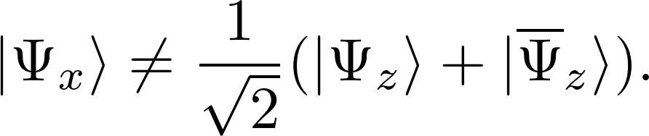
Rotations of spin using unrestricted KP
Cannot use standard Kramers pair method to obtain new spin if:
1) Wavefunction is unrestricted.
2) Wavefunction cannot be described by a
real function.
For relativistic Hamiltonians or unrestricted wavefunctions:

Slide 36
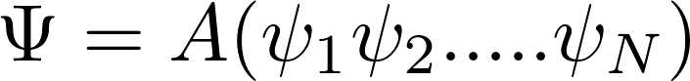
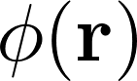
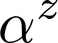
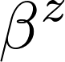
Rotations of spin using restricted KP
Kramers restricted wavefunction is given by:
i.e. identical for and orbitals:

Slide 37
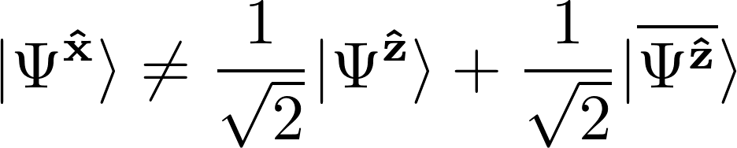
Rotations of spin using unrestricted KP
Kramers unrestricted wavefunction is given by:
i.e., different for and orbitals:

Slide 38
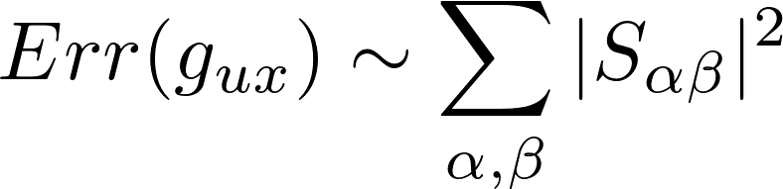
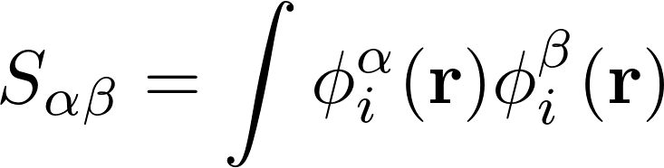
Accounting for this error
Difficult to obtain correct wavefunction.
Largest error is in the spin-Zeeman term.
Unrestricted wavefunctions yield anisotropic spin-Zeeman contributions even the absence of relativistic effects.
Correction to the spin-Zeeman terms for directions perpendicular to the orientation of spin of the wavefunction is found to be approximately equal to the spin-contamination.

Slide 39
Adjusted Results
Molecule |  | ReSpect | ReSpect (adj.) | Experiment^{a,b}
H₂CO+ | g_{x} | 0.9 | 4.9 | 4.6
 | g_{y} | 11.0 | -0.0 | 0.2
 | g_{z} | -0.9 | -0.9 | -0.8
H₂O+ | g_{x} | 4.7 | 0.3 | 0.2
 | g_{y} | 6.4 | 21.2 | 18.8
 | g_{z} | 3.7 | 5.9 | 4.8
Table 1. g-shift values in ppt. The molecules are in yz-plane, where z is along the main roation axis. ReSpect calculations were performed with spin parallel to the main rotation axis.
ªNe:H2CO matrix isolation result, from Knight et al. [L. B. Knight and J. Steadman, J. Chem. Phys. 80, 1018 (1984)]
^{b} H₂O+: Gas phase results derived from spin rotation data, from Knight et al.[ L. B. Knight and J. Steadman, J. Chem. Phys. 78, 5940 (1983)]

Slide 40
Protein docking
g-tensor is determined by the environment surrounding the paramagnetic centre.
Can provide information about the orientation of molecules with respect to the docking site.
Several organic compounds of interest exhibit regions of of negative spin density and/or exist in low spin states.
Q) How well is g-tensor theory adapted to unrestricted and/or broken symmetry DFT?
A) Transformation properties suffer but, depending on the method of calculation, principal values may be OK
P. J. Cherry, S. Komorovsky, V. G. Malkin, O. L. Malkina, Molecular Physics, 1-15, (2016).

Slide 41
Orientations of spin polarization
Wavefunction is not invariant under changes in the spin magnetization axis:
Magnetization direction | Total Energy (eV)
X | -14136.37547967025
Y | -14136.37547967033
Z | -14136.37556910989
Table 1: Energies obtained for different orienations of spin for HF calculations on I₂⁻. The bond is along the z-axis.

Slide 42
Orientation of spin magnetization
Associated g-tensors cannot be obtained from one another by rotations.
Magnetization direction | g_{para} | g_{perp} | g_{iso}
X | 1.956279 | 2.200348 | 2.118985
Z | 1.938658 | 2.251490 | 2.130441
Table 2: Principle g-values obtained for I₂⁻ using different directions of spin magnetization. The bond is along the z-axis.

Slide 43
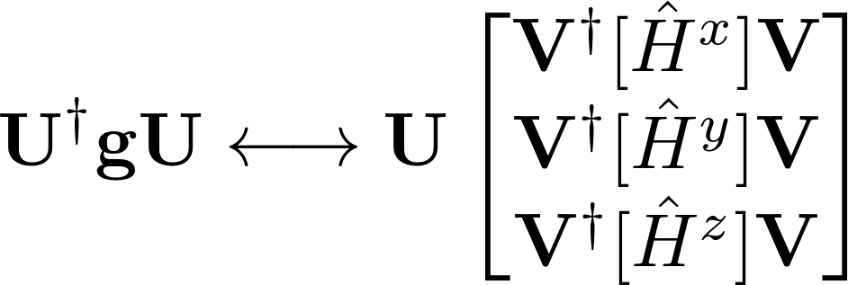
Rotations of g-tensor
Transformations of the g-tensor correspond to transformations of the spin Hamiltonian:
The V are rotations in SU(2); “spin-space”.
To understand issues must understand the spin Hamiltonian.
Assume errors in g-tensor arise from the failures of the spin-Hamiltonians to approximate degenerate perturbation theory.

Slide 44
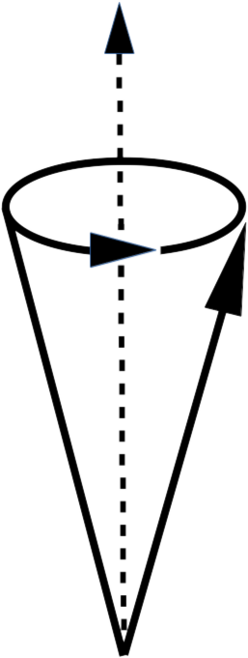
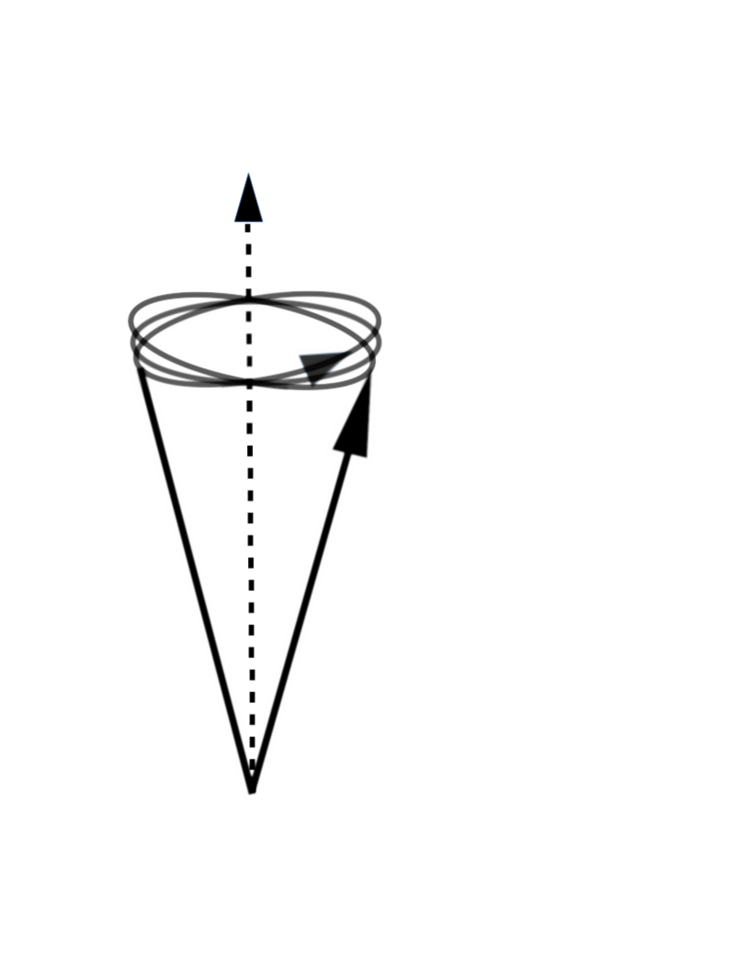
Spin precession in a relativistic framework
B
B
M
M
Non-relativistic: Spin and angular momentum decoupled. Precession of magnetic moment is planar.
Relativistic: Spin and angular momentum are coupled. Precession of molecular magnetic moment is more complicated.

Slide 45
Features of relativistic spin precession
Characterization of precession is more complicated; imaginary component of the signal may become more important.
T₂ could be affected; over thousands of revolutions even small deviations from a planar orbit could become significant.
Forbidden transitions between different spin multiplets may occur, and (potentially) be characterized from from the EPR spectra.

Slide 46
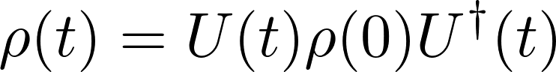
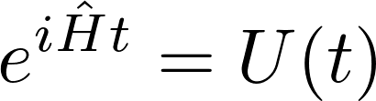
Time evolution of density matrix
Define how the density evolves in time using the time evolution operator:
Determine time evolution operator from Hamiltonian:

Slide 47
Time evolution
Define how the system evolves in time:
Determine this evolution from the Hamiltonian:
Approximate Hamiltonian with the g-tensor, hence the g-values connected changes in the Larmor frequency.

Slide 48
Restrict Hamiltonian to one multiplet
Restricted basis Zeeman Hamiltonian:
Mapping between g-tensor and spin-Hamiltonian:
U : real space rotation , V : spin space rotations

Slide 49
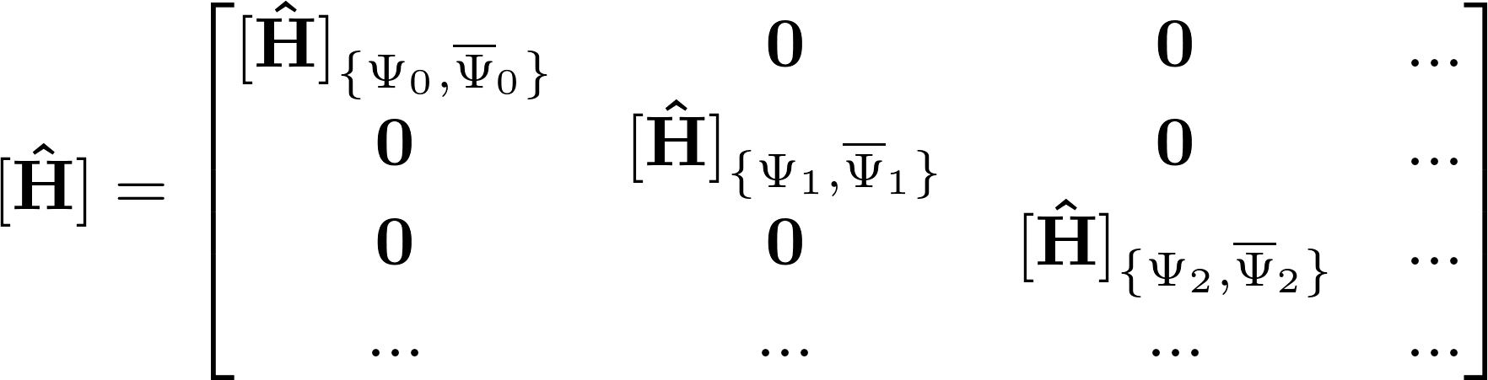
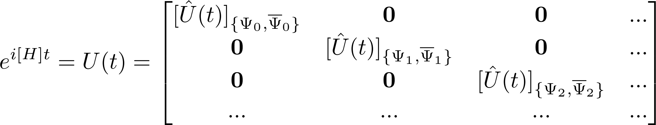
g-tensors for excited states
Standard tensor approximations assume that the pertubing Hamiltonian is block diagonal:

Slide 50
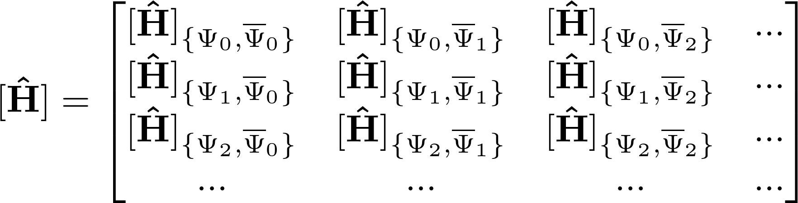
Strong spin-orbit coupling
The Zeeman Hamiltonian is not block diagonal

Slide 51
Restrict Hamiltonian to one multiplet
Restricted basis Zeeman Hamiltonian:
Mapping between g-tensor and spin-Hamiltonian:

Slide 52
Restrict Hamiltonian to one multiplet
Restricted basis Zeeman Hamiltonian:
Mapping between g-tensor and spin-Hamiltonian:
Does not hold in relativistic framework!

Slide 53
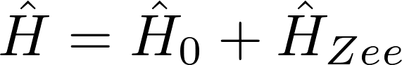
Strong spin-orbit coupling
The Zeeman Hamiltonian is not block diagonal
Non-linear Zeeman splitting at low magnetic fields.

Slide 54
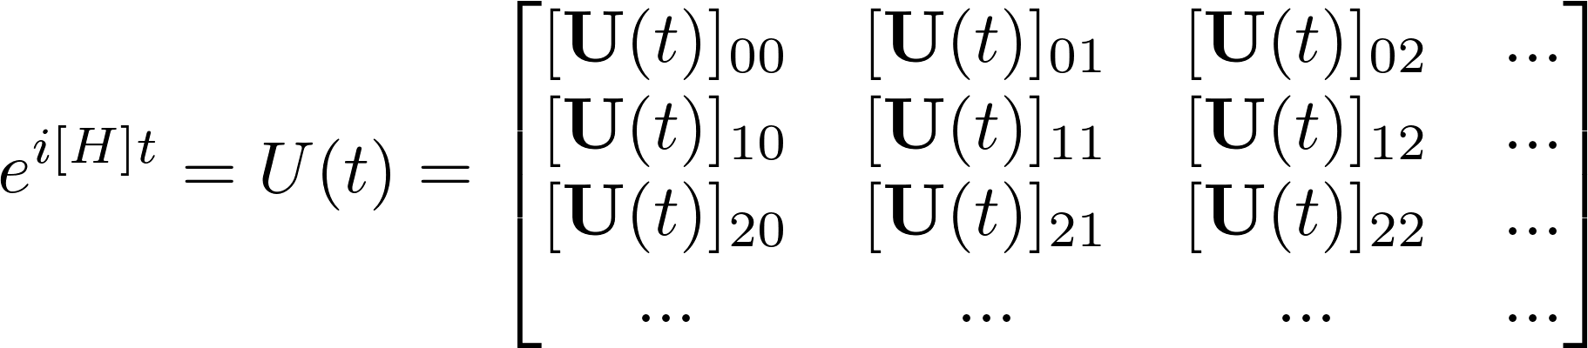
Strong spin-orbit coupling
Red square correspond to “forbidden” mixing of different spin multiplets.
These forbidden transitions are inherently impossible to describe with a g-tensor, as it is constructed from a single multiplet.

Slide 55
Strong spin-orbit coupling
Zeeman Hamiltonian is not block diagonal, hence the time evolution operator is not block diagonal.
Forbidden transitions can be interpreted as causing the distortion of the Larmor precession.

Slide 56
Non-linear Zeeman splitting at low |B|
Magnetic field must compete with the field arising from the electron’s orbital angular momentum.
Consequent non-linearity when the size of these two fields is comparable.
Note that the g-tensor is typically measured at much larger fields.

Slide 57
Zeeman splitting for H2O+
Low spin-orbit coupling : linear response

Slide 58
Non-linear Zeeman splitting at low |B|
Magnetic field must compete with the field arising from the electron’s orbital angular momentum.

Slide 59

Acknowledgements
People
Vladimir Malkin and Olga Malkina (Bratislava).
Stanislav Komorovsky (TromsØ).
Michal Odelius and Jozef Kowalewskii (Stockholm).
Juha Vaara (Oulu).
Giacomo Parigi, Claudio Luchinat, Enrico Ravera (Florence).
Lukas Konecny, Michal Repisky, Jiri Mares, James Asher, Arobendo Mondal, Shehryar Khan, Syed Awais Rouf.
Funding
The research leading to these results has received funding from the People Programme (Marie Curie Actions) of the European Union's Seventh Framework Programme (FP7/2007-2013) under REA grant agreement n°317127.

Slide 60
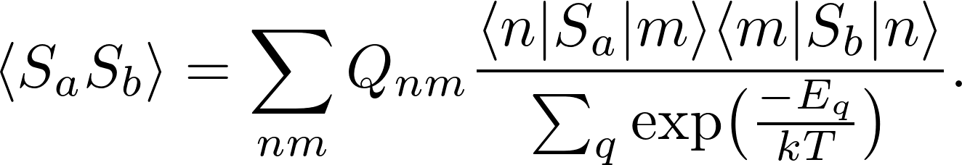
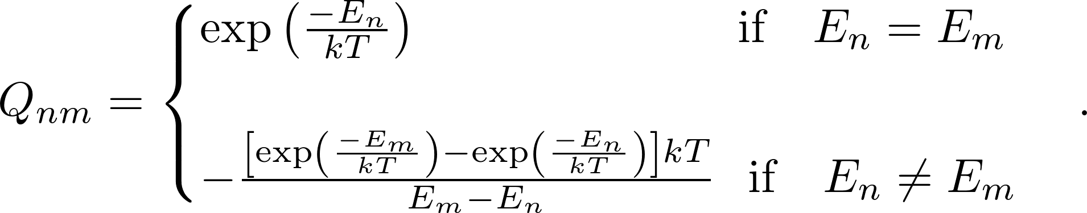
SS dyadic

Slide 61
Dirac-Kohn-Sham
Many electron system:
Potential closely resembles that for NR-DFT:
The wavefunction is approximated by a single, non-collinear unrestricted determinant.
Nuc-el
el-el
xc-potential
S. Komorovský, M. Repiský, O. L. Malkina, V. G. Malkin, I. M. Ondík, and M. Kaupp, The Journal of Chemical Physics 128, 104101, (2008).

Slide 62
Extension to multideterminant framework
Spin-Energy anisotropy : Apply a magnetic field in different directions and see how different strengths of magnetic field are required to reorientate the spin.
Density Matrix Formalism: The theory is equivalent in both cases, so the application should be straightforward.
Spin-Spin coupling enhancement : In theory this should be possible in the Dirac code. However, the implementation was found to be very time consuming, so it is likely there are non-obvious, technical problems.

Slide 63
Significance of correlation in relativistic open-shell systems
Correct treatment of correlation is very important:
Empirical exchange correlation functionals are primarily developed by considering systems where effects are negligible, so these functionals may be less than ideal.
Similarly, analytic exchange correlation functionals, such as PBE, are not derived in a non-relativistic framework.
Method | Total Energy (Hartree)
HF | -14226.581561867592
DFT (LDA) | -14219.567891349696
DFT (BP86) | -14234.262461138294
Table 1: Ground state energies calculated in ReSpect-mDKS for an I₂⁻ molecule.

Slide 64

Significance of correlation for ZFS
Correlation is particularly important for properties such as ZFS, which are determined by the interaction of multiple unpaired electrons:
Fig. 1: Ni(H₂O)₆
Fig 2: Plot of the variation in ZFS parameter, D, with increasing distortion of Ni-O bond as calculated from DFT(BP86) and several multireference methods. Multi-reference methods used all states generated from an (8, 5) active space. QDPT= Quasidegenerate perturbation theory.
A. Kubica, J. Kowalewski, D. Kruk, & M. Odelius, J. Chem. Phys. 138(6), 064304 (2013).

Slide 65


Spin contamination adjustment
In non-relativistic systems the approximation seems to work fairly well.
Fig.1: Variation in the discrepancy between spin-Zeeman contributions for the H₂O⁺ g-tensor calculated using expectation values and cross-terms with increasing spin-orbit interaction.

Slide 66


Spin contamination adjustment
The adjustment works less well for systems with substantial relativistic effects.
Fig.1: Variation in the discrepancy between spin-Zeeman contributions for the I₂⁻ g-tensor calculated using expectation values and cross-terms with increasing spin-orbit interaction.

Slide 67
Phase factors resulting in a spin transformation
Multiplication of the entire wavefunction by a phase factor is equivalent to a rotation in SU(2):

Slide 68
Transformations of individual spins
If the orbitals are orthogonal the overlaps are unchanged :
If the orbitals are not orthogonal
A shift in the phase of an individual orbital will shift the phase of the wavefunction by a similar amount.
No effect on expectation values when the two wavefunctions are the same.

Slide 69
Transformations of individual spins
If the wavefunctions are different then
The will be dependent upon the phase of the wavefunction, hence the matrix element will also depend upon the phase.
Note that the wavefunction is completely unrestricted, hence the molecular orbitals do not form Kramers pairs, so there is no need to constrain the phase during optimization.

